Slide 1



1 dia de Imersão
em Go❤️

Slide 2
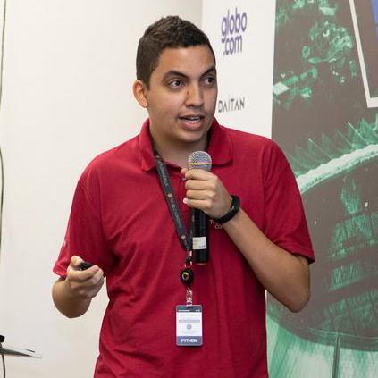



Quem sou eu?
Rodrigo Brito
https://github.com/rodrigo-brito
https://www.linkedin.com/in/rodrigofbrito
Mestre em Ciência da Computação - UFMG
Engenheiro de Software Sênior - Mercado Livre

Slide 3
Goroutines &
Channels
Explorando o mundo assíncrono

Slide 4

Cenário Atual

Slide 5
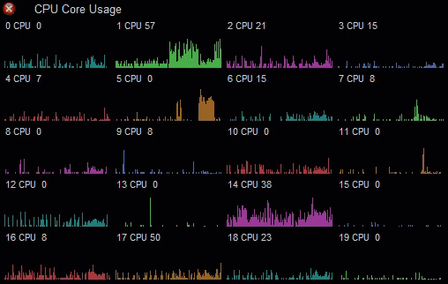

Slide 6

Coroutines
Actors
Generator
Fibers
Threads
Goroutines

Slide 7
Atividades Síncronas
100 seg.
Tarefa A
50 seg.
Tarefa B
Soma dos tempos das atividades
25 seg.
Tarefa C
175 segundos

Slide 8
Atividades Assíncronas
Tarefa A
100 seg.
Tarefa B
50 seg.
Tempo da atividade mais lenta
Tarefa C
25 seg.
100 segundos

Slide 9
Atividades Síncronas
func Log(message string) {
Save(message) // 100 ms
Notify(message) // 50 ms
Print(message) // 10 ms
}

Slide 10

Atividades Assíncronas
func Log(message string) {
go Save(message) // 100 ms
go Notify(message) // 50 ms
go Print(message) // 10 ms
}

Slide 11
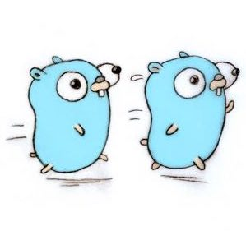
Atividades Assíncronas
Como eu sei que já finalizou?
func Log(message string) {
go Save(message) // 100 ms
go Notify(message) // 50 ms
go Print(message) // 10 ms
}
Quem termina primeiro?

Slide 12

Atividades Assíncronas
func Log(message string) {
go Save(message) // 100 ms
go Notify(message) // 50 ms
go Print(message) // 10 ms
time.Sleep(time.Second)
}

Slide 13
Wait Groups
func Log(message string) {
wg := new(sync.WaitGroup)
wg.Add(3)
go Save(message, wg)
go Notify(message, wg)
go Print(message, wg)
wg.Wait() // wait group
}
func Save(message string,
wg *sync.WaitGroup) {
database.Save(message)
wg.Done() // finalizei!
}

Slide 14

Wait Groups
func Log(message string) {
wg := new(sync.WaitGroup)
wg.Add(3)
go Save(message, wg)
go Notify(message, wg)
go Print(message, wg)
wg.Wait() // wait group
}

Slide 15
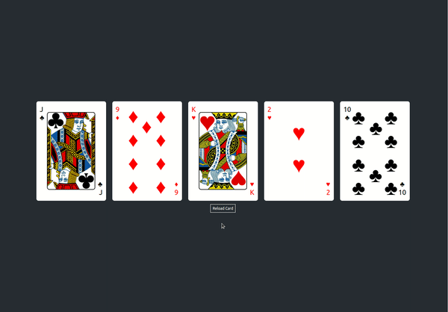

Slide 16
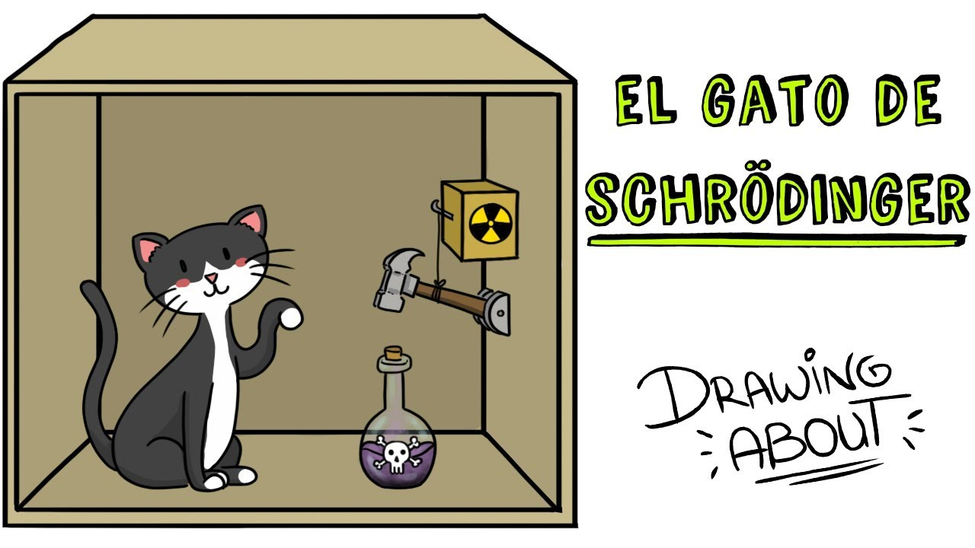
Race Condition
var counter int64
func increment() {
counter++
}
func main() {
for i := 0; i < 1000; i++ {
go increment()
}
time.Sleep(time.Second)
println(counter) // 1000?
}
Playground: https://go.dev/play/p/62z932IIdpN

Slide 17


Acesso Concorrente
Leitura + Escrita
Escrita + Escrita
Leitura + Leitura

Slide 18
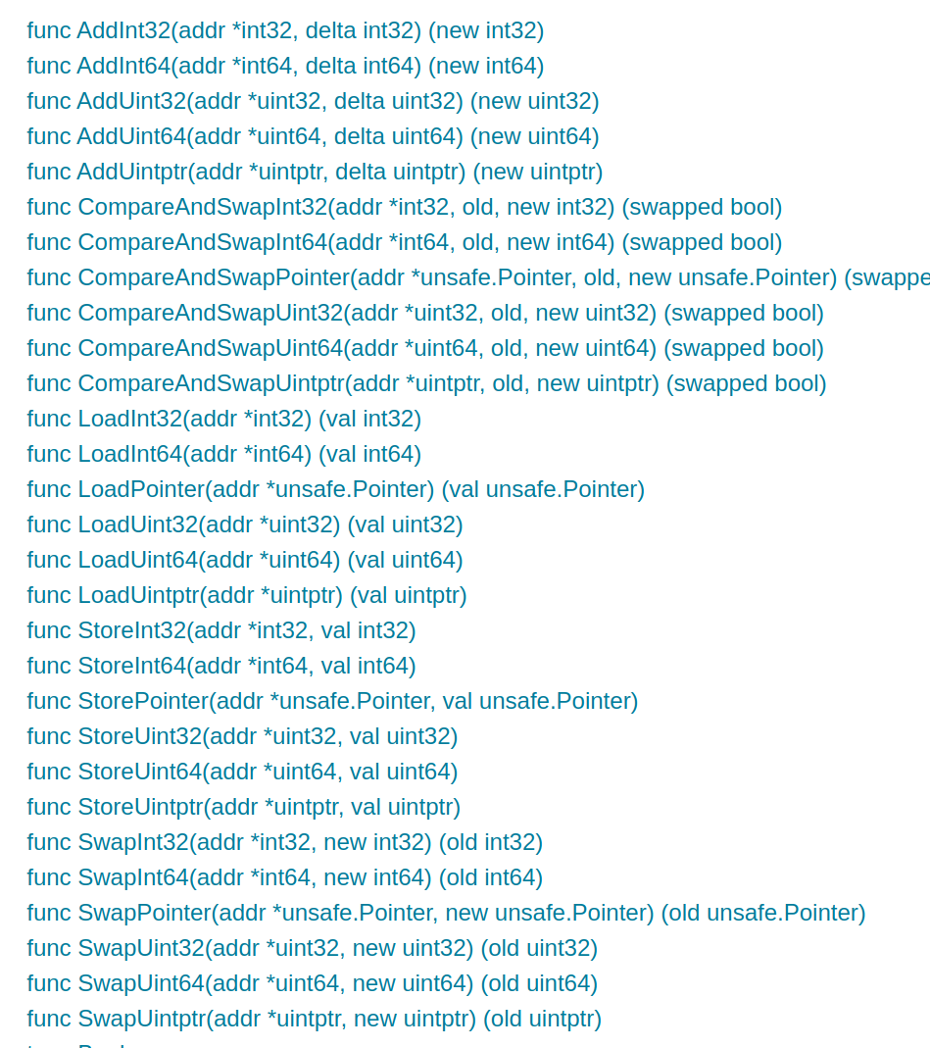
Package Atomic
var counter int64
func increment() {
atomic.AddInt64(&counter, 1)
}
func main() {
for i := 0; i < 1000; i++ {
go increment()
}
time.Sleep(time.Second)
println(counter) // 1000! (Correto)
}
Playground: https://go.dev/play/p/48tplcLr-_G

Slide 19

Mutex
var (
counter int64
mutex sync.Mutex
)
func increment() {
mutex.Lock()
defer mutex.Unlock()
counter++
}
Playground: https://go.dev/play/p/BP6faHfUK5A

Slide 20

Mutex
Goroutine 1
Goroutine 2

Slide 21
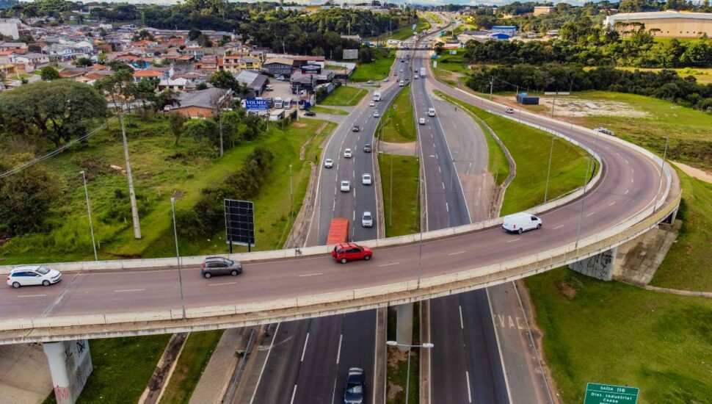

Slide 22
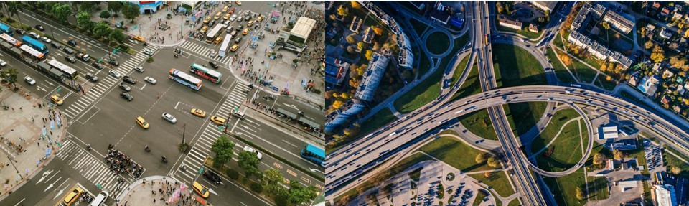
Mutex vs Channel

Slide 23
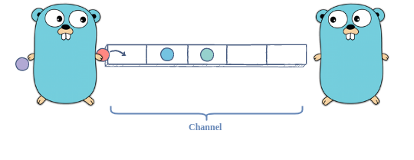
Goroutine 1
Goroutine 2

Slide 24
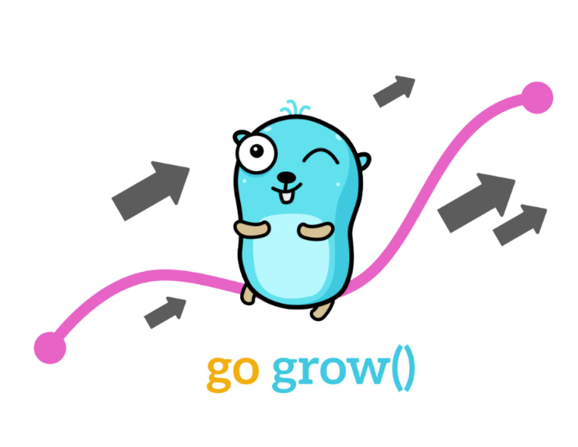
Channel
// criar canal
channel := make(chan int)
channel := make(chan int, 5) // buffer
// Leitura
value := <-channel
// Escrita
channel <- 13
// iterar valores que são recebidos
for i := range channel {
println(i)
}

Slide 25

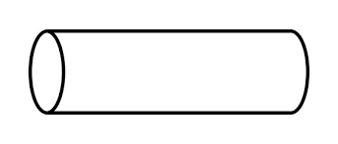
Channel
go sender(ch)
chan *Email
go sender(ch)
go sender(ch)

Slide 26
Escrita Channel
messages := []string {
"Hello",
"Gophers",
"Goroutine",
"Comunity",
"Example",
}
channel := make(chan string)
for _, message := range messages {
channel <- message
}

Slide 27
Leitura Channel
func consumer(channel <- chan string, wg *sync.WaitGroup) {
for message := range channel {
sendEmail(message)
}
wg.Done()
}
wg := new(sync.WaitGroup)
wg.Add(2)
// Duas goroutines consumidoras
go consumer(channel, wg)
go consumer(channel, wg)
Playground: https://go.dev/play/p/LIRDOTSRRkE

Slide 28
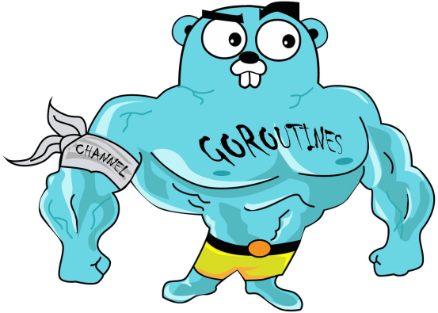

Slide 29


Muito obrigado,
Gophers!
Me acompanhe nas redes
https://brito.com.br
https://github.com/rodrigo-brito
https://www.linkedin.com/in/rodrigofbrito

